Slide 1


DO YOU HAVE AN ISSUE WITH
Managing Your Time?

Slide 2



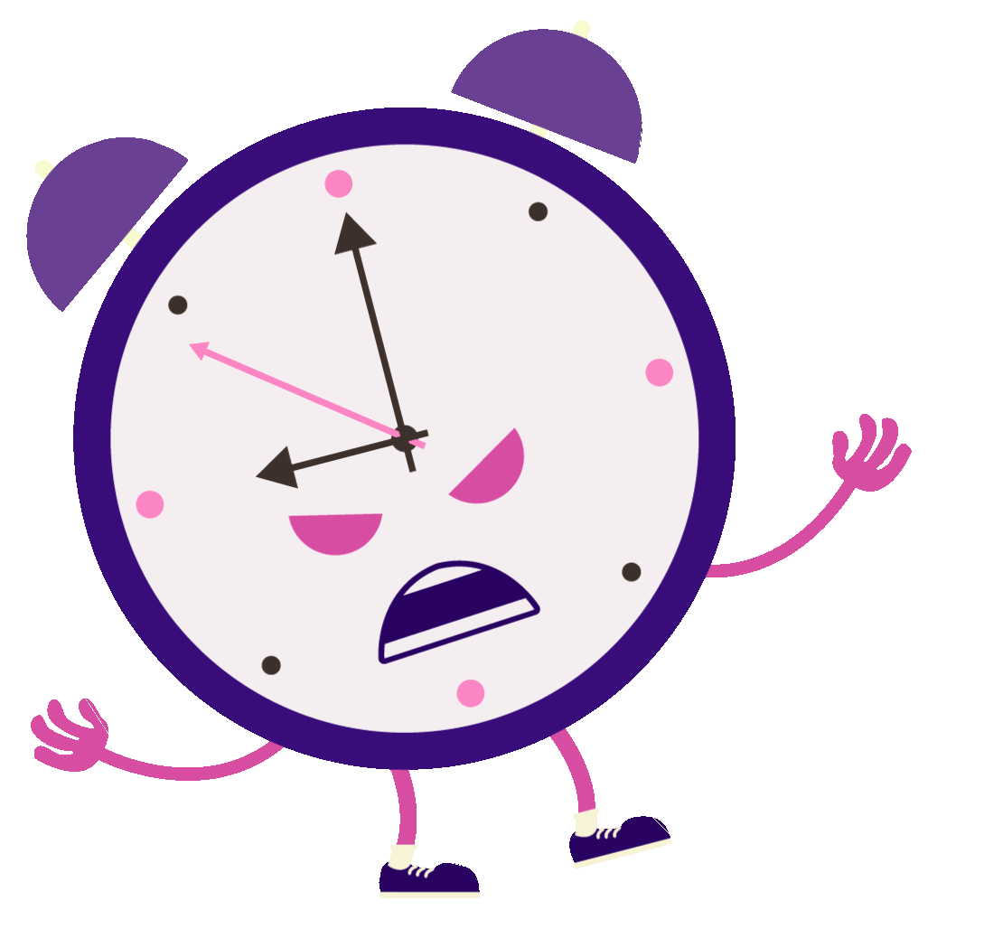

HAVE YOU MISSED AN IMPORTANT
ENGANEMENT DUE TO POOR
Time Management?

Slide 3








Learning how to
is an invaluable
manage your time
asset if you desire
TO BE SUCCESSFUL AND ACHIEVE YOUR GOALS

Slide 4



WHETHER IN YOUR
Personal life or
Y O U R B U S I N E S S

Slide 5





THIS IS WHY YOU NEED TO LEARN
how to manage whatever time
YOU HAVE EFFECTIVELY

Slide 6



Levidio
WAS PUT TOGETHER IN A STEP
by step format
DETAILING THE MOST EFFECTIVE
STRATEGIES FOR TIME MANAGEMENT

Slide 7






IT WILL HELP YOU IDENTIFY THE MEASURES REQUIRED TO CUT DOWN ON
THOSE DAILY TASKS THAT STEAL YOUR TIME
Which You May Not Be Able To Identify

Slide 8





that will help you get the most
Out of your day without feeling burned out
You’ll learn everything you need
To know in a simple and easy TO FOLLOW SYSTEM

Slide 9





Take action right now and start getting
A stronger hold on your day
CLICK FOR INSTANT ACCESS
you can find on

Slide 10
VISIT NOW

Slide 11
www.yourdomain.com

